Slide 1
SUSTAINED USER ENGAGEMENT
Sofia Yfantidou (ESR14), Aristotle University of Thessaloniki (AUTH)

Slide 2
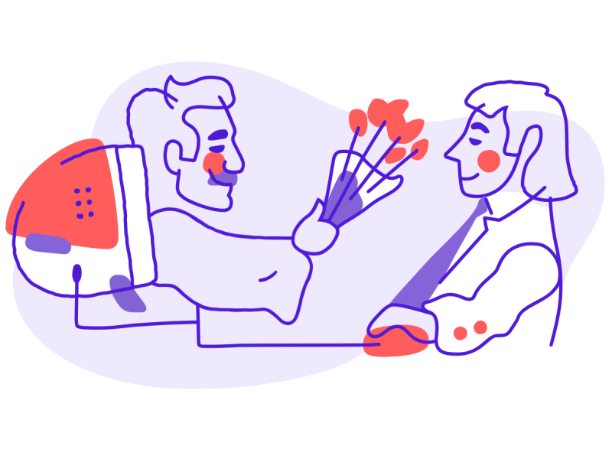
Contents
Sustained User Engagement: Problem Statement
The Hook Model
Persuasive Systems Design Framework
Measuring User Engagement
Ethics
Image Source: https://dribbble.com/shots/3918510-Customer-Engagement
Notes:
Today’s presentation is going to be slightly different than the previous seminars. As you already know, my work revolves around Sustained User Engagement in the Internet of Sports domain. And UE is not purely technical. On the contrary, it’s an interdisciplinary research field, incorporating principles from Psychology, Behavioral Sciences, Sports Science and of course Computer Science. Thus, today’s presentation is going to be a fascinating journey in the intersection of all these sciences.
Firstly, we’re going to see why user engagement in IoS is currently problematic.
Then we’re going to explore the Hook Model by Nir Eyal. This model is a four-phase process that creators can use to build products or services used habitually by customers to achieve sustained engagement.
After, we’re going to discuss the Persuasive Systems Design Framework, which provides practical guidelines on features and functionalities that creators should incorporate into their products, in order to achieve behavior change.
Finally, we’re going to briefly go over the art of measuring user engagement. Because in the end of the day, no matter how many models or frameworks we use, we need to evaluate how well they perform and how engaged our users are.

Slide 3
Problem Statement
What is the issue and what can be done?

Slide 4
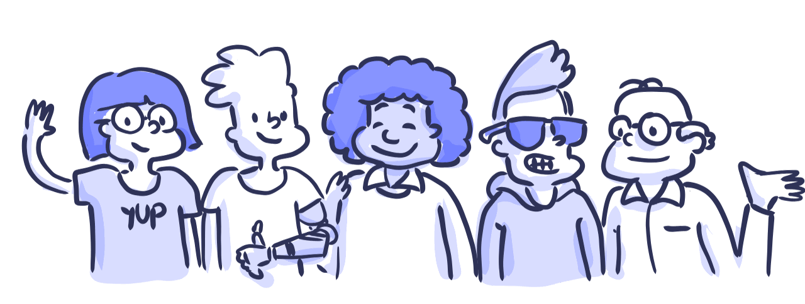
Wearables: The Market
1 in 5 Americans use a smart watch or fitness tracker in 2020
& 1 in 4 Americans will be using one by 2022 ^{[3,4]}
Image Source: https://www.gainsight.com/resource/thank-you-executive-guide-churn/

Slide 5
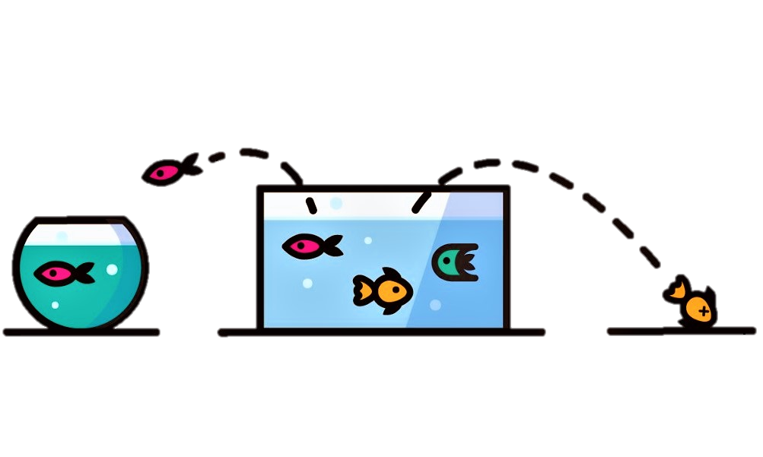


Wearables: The Abandonment Problem
Reported attrition rates vary significantly, but are nevertheless high
From 30% ^{[1]}
To >70% ^{[2]}
Image Source: https://towardsdatascience.com/how-do-you-measure-if-your-customer-churn-predictive-model-is-good-187a49a9eee3

Slide 6






Wearables: Reasons for abandonment ^{[5]}
Cost of collecting and integrating
Cost of having or sharing the data
Discomfort with information revealed
Data quality concerns
Learned enough
Life circumstances change
Notes:
Collecting and integrating refers to time cost as well – integrating (different companies, different platforms, e.g., Xiaomi Scale, Huawei Mobile Phone and Samsung Watch)
Having and sharing refers to privacy concerns
Discomfort: ignorance is bliss is the saying that best describes this reason. Wearables can boost your confidence in case of good performance, but they can also demotivate you in case of continuous bad performance or below average performance.
Data quality concerns: people doubt the accuracy of those devices
Learned enough: users who’ve already accomplished a high level of performance are more autonomous and may not need the device anymore
Life circumstances: lives and routines may change, leading people to intentionally or unintentionally suspend tracking, e.g., unexpected health issues, moving, work problems, etc.

Slide 7
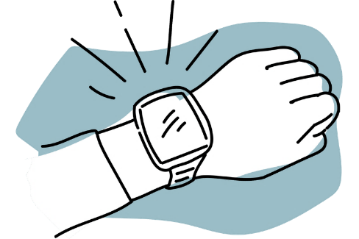

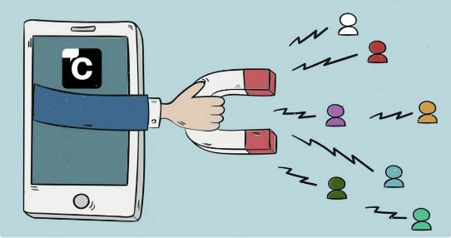
Wearables: The Solution
John’s presentation after summer
Create Habit Forming Wearables
+
Bring Value by Enhancing User Experience
=
Achieve Sustained User Engagement
Image Source: https://www.intelligenthq.com/increase-user-engagement/
Notes:
Create Habit Forming Wearables: The Hook Model
Bring Value by Enhancing User Experience: Persuasive System Design
Sustained User Engagement: How to measure it?

Slide 8
The Hook Model by Nir Eyal ^{[6]}
Creating Habit Forming Wearables

Slide 9
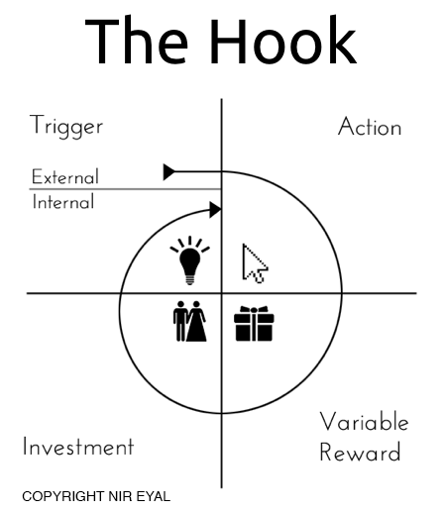
The Hook Model Phases
Image Source: https://www.alexandercowan.com/the-hook-framework/
Notes:
Give Pinterest Example for Uploading Pictures
Trigger: Notification/E-mail (your followers haven’t heard from you in a while)
Action: Simple action of 1-click photo upload
Variable Reward: Likes
Investment: You build a timeline by uploading pictures
The upload hook will create the next round of engagement (the next hook) starting with a notification “You have 20 new likes!”

Slide 10
The Hook Model: Trigger

Slide 11

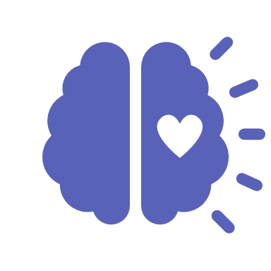
Trigger: Types of Triggers
There are two types of triggers:
External Triggers
Internal Triggers
E-mails
Notifications
Online ads
etc.
Emotions
Routines
Situations
etc.
The information for what to do next is within the trigger.
The information for what to do next is formed through associations in the user’s memory.
Notes:
External trigger example: Smart bands give us reminders to move after prolonged periods of sedentariness. The trigger (the reminder) explicitly tells us what to do next; sit up and do a stretch.
Internal trigger example: Let’s say we go out running weekly. After every run, we are programmed –if you allow me- to check our smart band or other wearable device for feedback on our performance. Here, there is not necessarily an external trigger to tell us to check our performance. However, we have formed an association in our brain which says that every time we finish running (situation cue), we should check our mobile or wearable for performance feedback. The trigger is the situation per se.
You should know here that internal triggers are more powerful than external triggers, because they imply a habitual nature. In other words, our product, e.g., a smartband, is so tightly coupled with the user’s reality that he or she does not even realise the reasons behind the usage of the product.
Of course persuasive technology is one form of manipulation and that’s why further on we’ll discuss about the ethics of it all.

Slide 12
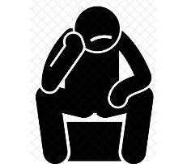




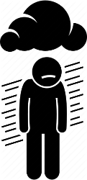

Trigger: Negative Emotions
Negative emotions are powerful internal triggers
Which internal triggers are driving wearable users?
Bored
Lonely
Check the “Five Whys” Technique ^{[7]}
Depressed
Image Sources: https://iconscout.com/, https://www.iconfinder.com/, https://thenounproject.com/
Notes:
The question is do we know the internal triggers of wearable users? And if yes, how can we reinforce a connection between these triggers and the use of our product?
Is it guilt of being inactive? Is it fear of the dangers of inactivity? We won’t discuss it further now, but if you’d like to know which are the internal triggers that drive your customers you may want to check out the “Five Whys” technique developed by Sakichi Toyoda, the Japanese inventor, and founder of Toyota Industries in the 1930s

Slide 13
The Hook Model: Action

Slide 14
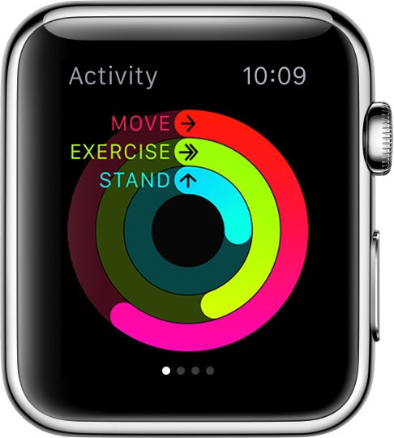
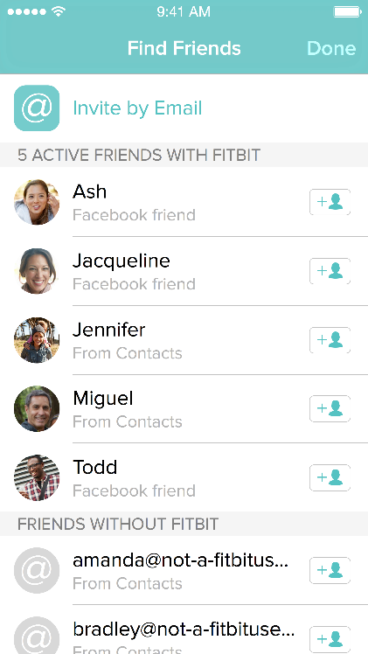
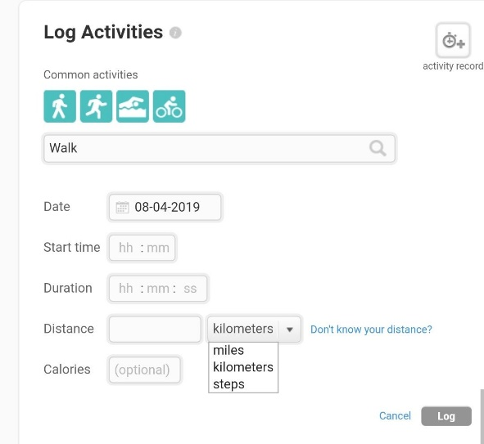

Action: Definitions
The simplest behavior in anticipation of a reward
Manually log an activity
Check Performance
Invite a friend
SIMPLE
COMPLICATED
Image Sources: https://osxdaily.com/, https://blog.fitbit.com/, https://community.fitbit.com/
Notes:
For the most successful products their core action is extremely simple. For Facebook and Instagram it’s wall scrolling, for Google is search, for YouTube it’s play.
For wearables I’d say it is the action of checking for performance feedback. There is an element of surprise there which works well with our brain’s reward system as we’ll see later. However, there are more complicated actions to be performed as well, such us friend invitations and manual activity logging. However, the more complicated an action is, the higher ability and motivation it requires to perform.

Slide 15
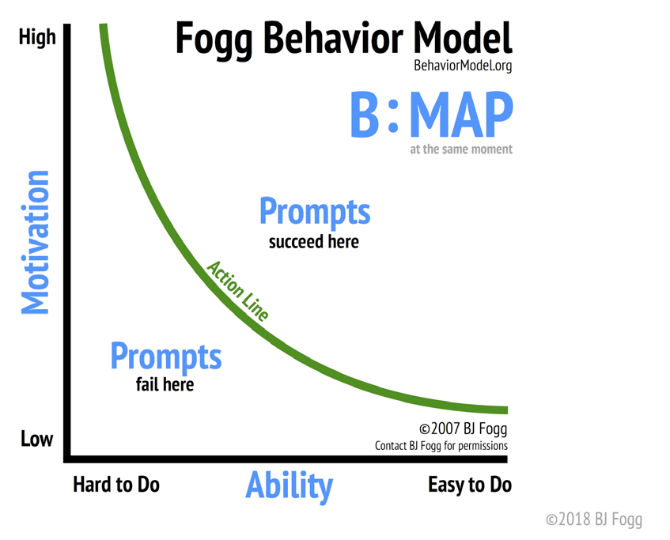
Action: Fogg Behavior Model ^{[8]}
To increase the desired behavior, ensure a clear trigger is present; next, increase ability by making the action easier to do; finally, align with the right motivator.
Image Source: https://www.klipfolio.com/blog/implementing-okrs-better-and-faster
Notes:
The Fogg Behavior Model (FBM) highlights three principal elements as the drivers of behavior.
This framework has been widely applied and proven to be valid in multiple situations.
For a behavior to occur we need 3 elements coming together at one moment.
Motivation; People have to be sufficiently motivated to want to change their behavior
Ability; People must have the ability to perform the target behavior
Prompt; There needs to be a prompt/trigger (internal or external) or prompt to encourage the adopt a certain behavior behavior.
For example. Let’s say we have a wearable paired with a mobile app that recommends training schedules to users. A prompt to exercise would fail unless the user shows a medium to high level of motivation; namely they must want to do it. That is because exercise is not an easy task to do, like simple scrolling. On the contrary it requires substantial effort from the user. Thus, the user needs to be sufficiently motivated for a prompt to succeed.

Slide 16






Action: Core Motivators
Seeking pleasure and avoiding pain
Seeking hope and avoiding fear
Seeking social acceptance while avoiding social rejection
Notes:
1… 2… 3…
Fitness generally may clash with the pleasure vs. pain motivator, as exercise can be a demanding task for the average user. Thus, taking into account the previous model and the fact that motivation is the last element of the model we should try and change, in the case of exercise we should opt to increase the ability element for those users with lower motivation; namely, we should make the task of exercise as easy and integrated as possible to the user’s everyday life.

Slide 17




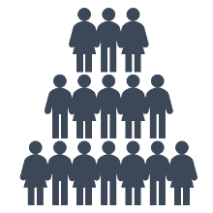

Action: Ability Influence Factors
Time
Money
Physical Effort
Six factors can increase or decrease ability
Brain Cycles
Social Deviance
Routine
Notes:
Take every influence factor and ask regarding exercise and how can we decrease the effect
e.g., how can we decrease the time investment required from a user to exercise? Can we suggest time efficient workouts? Or maybe can we plan jogging routes for them, so that they don’t have to spend time thinking about where to do their morning run?
Similarly, how can we decrease the deviance from the user’s routine? Can we incorporate exercise into the user’s daily schedule, e.g., by integrating the user’s calendar or promoting active transport or active breaks at work?
Technological solutions should focus on increasing the user’s ability rather than motivation. Essentially these factors.

Slide 18
The Hook Model: Variable Reward

Slide 19
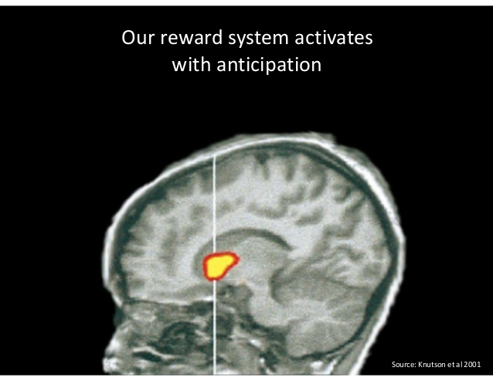
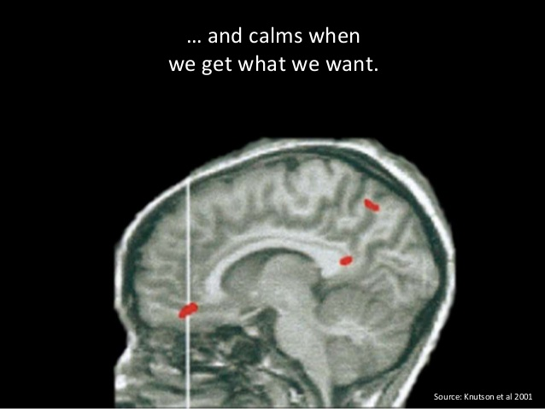
Reward: Scratching the Itch
Anticipation of a reward stimulates the stress of desire ^{[9]}
Variability increases the stress of desire and increases behavior!
Image Source: https://www.slideshare.net/GoAtlassian/hooked-how-to-build-habitforming-products-nir-eyal
Notes:
Notice here that in the Hook Model, we’re talking about Variable Rewards. Variability increases the stress of desire and increases behavior. An expected reward, e.g., a badge at the end of the day if you complete your 10000 steps might lead to anticipation but for sure does not supercharge your anticipation like Facebook scrolling does, where with the move of a finger you get an abundance of new information.

Slide 20

Reward: Types of Rewards
3 Types of Variable Rewards
To create habit-forming products we need to use 1 or more
Image Sources: https://www.slideshare.net/GoAtlassian/hooked-how-to-build-habitforming-products-nir-eyal
Notes:
Rewards of the tribe: the search for social rewards fueled by connectedness with other people. It’s no wonder that the use of social media has exploded over the past few years. Facebook and Twitter, to name just two of the most popular examples, provide well over a billion people with powerful social rewards on a variable schedule. With each tweet and post, users wonder how much social validation they’ll receive.
Rewards of the hunt: But as sociable as we are, our individual need for sustenance is even more crucial. The need to acquire physical things, such as food and supplies, is part of the brain’s operating system and we clearly wouldn’t have survived the millennia without this impulse. But where we once hunted for food, today we hunt for deals and information. See Twitter for instance, which provides endless new information with a single scroll.
Rewards of the self: Finally, there are the variable rewards we seek for personal gratification. The search for intrinsic rewards of mastery, competence, and completion. For instance goal achievement and moving up levels are some examples of this type of reward in the IoS setting.

Slide 21
The Hook Model: Investment

Slide 22

Investment: Types of Investment
Data
Social Capital
Time
Emotional Commitment
Effort
Money
Notes:
Users invest for future benefits. We invest time, money, data, … and some examples for wearbles

Slide 23
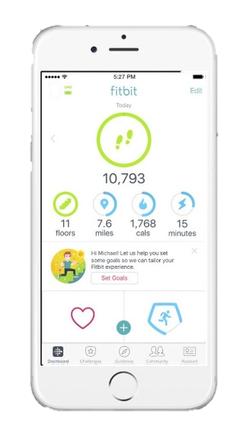
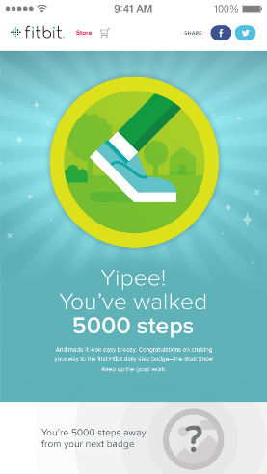


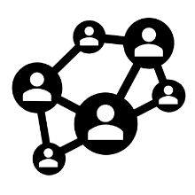

Investment: Why is it Important?
Investments load the next trigger of the hook
Investments store value improving the product with use
New External Trigger: Accomplishment Notification for New Goal
Investment: Personal Goal Setting
Content
Data
Followers
Reputation
Image Sources: https://www.pinterest.com/pin/214413632235794356/, https://blog.fitbit.com/fitbit-personal-goal-setting-announcement/
Notes:
Unlike the action phase, which delivers immediate gratification, the investment phase concerns the expectation of a future benefit.
Investments increase the likelihood of users passing through the Hook again by loading the next trigger to start the cycle all over again
Investments increase the likelihood of users returning by improving the service the more it is used. Investments “store value” in the form of content, data, followers, reputation, and skill.

Slide 24
Persuasive Systems Design (PSD) ^{[10]}
Behavior Change through User Experience Design
Notes:
Fogg’s functional triad and the design principles presented in it constitute the first and so far, most utilized conceptualization of persuasive technology. A weakness of this model is that it does not explain how the suggested design principles can and should be transformed into software requirements and further implemented as actual system features. Yet, to be able to design and evaluate the persuasiveness of a software system, it becomes essential to understand both the information content and the software functionalities.

Slide 25
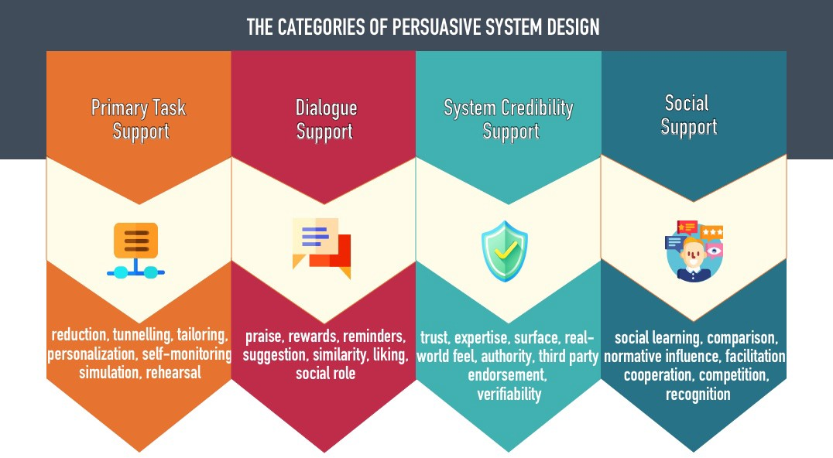
PSD: Overview
A framework for Persuasive Systems Design (PSD) developed in 2009 listing 28 design principles for persuasive system content and functionality.
Image Source: https://medium.com/@yesm.sahn/learn-the-best-design-practices-applied-by-the-biggest-e-commerce-web-sites-f48d20b37361
Notes:
The categories for persuasive system principles suggested in this article are primary task, dialogue, system credibility, and social support. Now, we’re going to explore them one by one along with IoS-inspired examples.

Slide 26
PSD: Primary Task Support
Reduction: Reduces complex behavior into simple tasks
Tunneling: Guides user through a process and persuade along the way
Tailoring: Provides information tailored to different user groups
Personalization: Offers personalized content and services to the users
Self-monitoring: Provides means to track the user’s performance
Simulation: Provides means to observe the link between cause and effect
Rehearsal: Provides means for rehearsing target behavior
Notes:
Reduction: e.g., instead of recommending a 30-min exercise per day, provide various 30-min exercise plans that the user can follow step-by-step
Tunneling: Health app provides information on how to achieve exercise goal after the user has set up their short-term and long-term goals profile
Tailoring: Fitness app providing different goals and exercise schedules based on the age-group or the fitness level of the user
Personalization: adaptive goal setting based on user’s past behavior, schedule, external conditions, etc.
Self-monitoring: Kind of a given now with activity trackers
Simulation: a fitness app that provides visualizations about active hours within a day. This way the user can connect situations and places with activity or sedentariness
Rehearsal: a smartwatch that provides “reminder to move” alerts and shows an animated character that rehearses the recommended stretching behavior along with the user

Slide 27
PSD: Dialogue
Praise: Praises user on good behavior via various means
Rewards: Provides virtual rewards to users for performing target behavior
Reminders: Reminds users of their target behavior
Suggestion: Suggests that users carry out certain behaviors towards goals
Similarity: Imitates users in some way and remind them of themselves
Liking: Visually attractive system
Social Role: Adopts a social role
Notes:
Praise: goal accomplishment messages/notifications
Rewards: Badges and points system for activity
Reminders: smartwatch reminders to move every 1h
Suggestion: Suggest various exercise plans to users
Similarity: Use of slang for fitness app for teenagers, or use of elderly in videos demonstrating exercises in a fitness app for older adults
Liking: minimal design; or according to the period’s standards, you cannot put comic sans in there
Social role: system as a trainer

Slide 28
PSD: System Credibility
Trustworthiness: Provide information that is truthful, fair and unbiased
Expertise: Provide information showing knowledge, experience and competence
Surface Credibility: Have competent look and feel
Real-world Feel: Provide information about the organization and/or creators
Authority: Refer to people in role of authority
Third-party Endorsements: Provide endorsements from respected sources
Verifiability: Provide means to verify the accuracy of site content via outside sources
Notes:
Trustworthiness: Company Web site provides information related to its products rather than simply providing biased advertising or marketing information.
Expertise: Mobile application is updated regularly and there are no dangling links or out-of-date information / fitness application which is build in cooperation with certified trainers
Surface credibility: There are only a limited number of, and a logical reason for, ads on a Web site or mobile application
Real-world feel: App provides possibilities to contact specific people through sending feedback or asking questions.
Authority: Fitness app quotes World Health Organization when it comes to recommended MVPA minutes goal per week.
Third-party endorsements: Web site refers to its reward for high usability / fitness apps partnering with well known institutions, companies and organizations
Verifiability: Claims on a Web site are supported by offering links to other web sites.

Slide 29
PSD: Social Support
Social Learning: Provide means to observe others who perform the same behavior
Social Comparison: Provide means to compare performance with other users
Normative Influence: Use normative influence to persuade user perform behavior
Social Facilitation: Provide means to discern users performing the behavior
Cooperation: Provide means for co-operation
Competition: Provide means for competing with other users
Recognition: Provide public recognition for users who perform target behavior
Notes:
Social Learning: discussion forums for users with similar exercise profiles
Social Comparison: connected fitness trackers that show you your exercise buddy’s steps at this time of the day so that you can compare with your own progress
Normative Influence: a histogram chart of all users which shows where user stands when it comes to activity, e.g., you’re among the top 20% of all users
Social Facilitation: fitness app with activity challenges that tells you how many users are participating along with you in the challenge
Cooperation: collective step goal
Competition: online activity competitions among users (walking competitions)
Recognition: leaderboards with the top user

Slide 30
Measuring User Engagement (UE) ^{[11]}
It is really working?

Slide 31



UE: Overview
User engagement is a quality of the user experience
that emphasizes the phenomena associated with wanting to
use a technological resource longer and frequently. ^{[12]}
UE can be measured through:
Self-reports
(e.g., emotions surveys)
Physiology
(e.g., gaze, movement)
Analytics
(e.g., user action logs)
Emotional Aspect
Cognitive Aspect
Behavioral Aspect
Notes:
Part of the user experience, it is not the user experience.
Self-reports might become obsolete in the future. For the moment being they’re used a lot in health behavior change research.

Slide 32
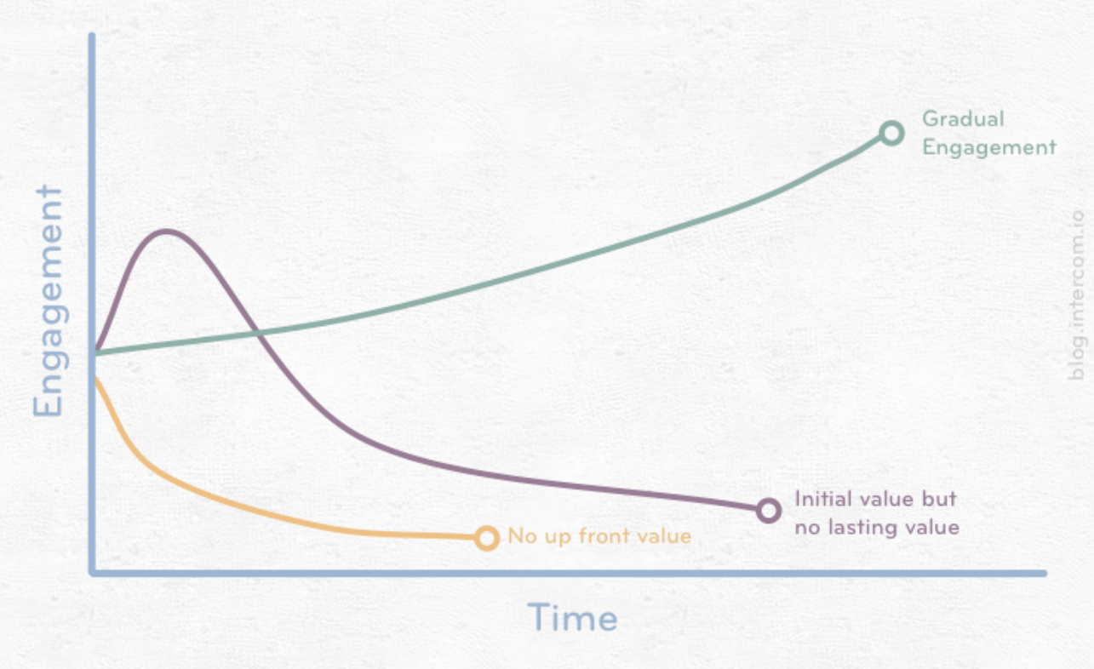
UE: Why is it important to measure
UE gives us insights about how successful the user journey is
UE is a complex construct; standardization of what it is and how to measure it will benefit research, designers and users
Image Source: https://fdocuments.in/document/www-tutorial2013-userengagement.html

Slide 33








UE: Attributes
Scale
Setting
One is not better than the other; it depends on
aims and constraints!
Small-scale
Large-scale
Lab
Field
Objectivity
Temporality
Subjective
Objective
Short-term
Long-term

Slide 34
UE: Measures
Approach | Measures | Attributes
Self-report | Questionnaire, Interview, think-aloud and think-after protocols | Subjective Short- and Long-term Lab and Field Small Scale
Physiology | EEG, SCL, fMRI, Eye Tracking, Mouse Tracking | Objective Short-term Lab (and Field) Small- and Large-scale
Analytics | Intra- and Inter-session Metrics, Data Analytics | Objective Short- and Long-term Field Large-Scale
Notes:
electroencephalogram (EEG)
Skin Conductance Level (SCL)
Functional magnetic resonance imaging or functional MRI (fMRI)

Slide 35
UE: Analytics
 | Intra-session Measures | Inter-session Measures
Single Site | Dwell Time / Session Duration Click Through Rate (CTR) Mouse Movement # Pages Viewed (Click Depth) Conversion Rate (CR) etc. | Fraction of Return Visits Inter-session Rate Lifetime Value # Sessions per Unit of Time Total Usage Time per Unit of Time # Friends on Site (SNs) etc.
Multiple Sites | Downstream Engagement Revisits etc.
Still no standardized framework for UE on wearable devices
Notes:
electroencephalogram (EEG)
Skin Conductance Level (SCL)
Functional magnetic resonance imaging or functional MRI (fMRI)
Downstream Engagement Score: Total time spent on provider sites from the next site until the end of the provider session, divided by the total remaining session time

Slide 36
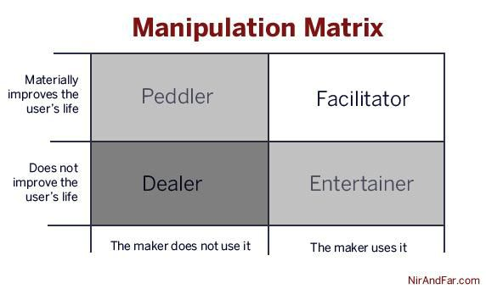
A Note on Ethics
Designing habit-forming products is a form of manipulation
Help people find meaning through your products.
Engage them in something important.
Image Source: https://www.forbes.com/sites/nireyal/2012/07/02/the-art-of-manipulation/#2a2749785009

Slide 37

Key Takeaways
More features is not the answer to the attrition problem; creating engaging products is
The Hook Model can help creators build habit-forming products
The Persuasive Systems Design framework can help developers build functionality for positive behavior change
Measuring User Engagement is crucial for quantifying the user journey
Build products that bring positive change to users lives

Slide 38
Bibliography
Medium. 2020. Inside Wearables Part 1: How Behavior Change Unlocks Long-Term Engagement. [online] Available at: https://medium.com/@endeavourprtnrs/inside-wearable-how-the-science-of-human-behavior-change-offers-the-secret-to-long-term-engagement-a15b3c7d4cf3 [Accessed 30 June 2020].
Rock Health. 2020. Deconstructing The Fitbit IPO And S-1 | Rock Health. [online] Available at: https://rockhealth.com/deconstructing-fitbit-s-1/ [Accessed 30 June 2020].
Pew Research Center. 2020. About One-In-Five Americans Use A Smart Watch Or Fitness Tracker. [online] Available at: https://www.pewresearch.org/fact-tank/2020/01/09/about-one-in-five-americans-use-a-smart-watch-or-fitness-tracker/ [Accessed 30 June 2020].
eMarketer. 2020. Wearables 2019. [online] Available at: https://www.emarketer.com/content/wearables-2019 [Accessed 30 June 2020].
Epstein, D.A., Caraway, M., Johnston, C., Ping, A., Fogarty, J. and Munson, S.A., 2016, May. Beyond abandonment to next steps: understanding and designing for life after personal informatics tool use. In Proceedings of the 2016 CHI Conference on Human Factors in Computing Systems (pp. 1109-1113).
Eyal, N., 2014. Hooked: How to build habit-forming products. Penguin.
En.wikipedia.org. 2020. Five Whys. [online] Available at: https://en.wikipedia.org/wiki/Five_whys [Accessed 1 July 2020].
Fogg, B.J., 2009, April. A behavior model for persuasive design. In Proceedings of the 4th international Conference on Persuasive Technology (pp. 1-7).
Knutson, B., Adams, C.M., Fong, G.W. and Hommer, D., 2001. Anticipation of increasing monetary reward selectively recruits nucleus accumbens. Journal of Neuroscience, 21(16), pp.RC159-RC159.
Oinas-Kukkonen, H. and Harjumaa, M., 2009. Persuasive systems design: Key issues, process model, and system features. Communications of the Association for Information Systems, 24(1), p.28.
Lalmas, M., O'Brien, H. and Yom-Tov, E., 2014. Measuring user engagement. Synthesis Lectures on Information Concepts, Retrieval, and Services, 6(4), pp.1-132.
Attfield, S., Kazai, G., Lalmas, M. and Piwowarski, B., 2011, February. Towards a science of user engagement (position paper). In WSDM workshop on user modelling for Web applications (pp. 9-12).

Slide 39













Beneficiaries / Partners
Beneficiaries
Partners

Slide 40

Acknowledgement
This project has received funding from the European Union’s Horizon 2020 research and innovation programme under the Marie Skłodowska-Curie grant agreement Innovative Training Networks (ITN) - RAIS No 813162

Slide 41
Social
www.rais-itn.eu

Slide 42
Table Example
Header 1 | Header 2 | Header 3 | Header 4 | Header 5
1 | 2 | 3 | 4 | 5
6 | 7 | 8 | 9 | 10
11 | 12 | 13 | 14 | 15
16 | 17 | 18 | 19 | 20
21 | 22 | 23 | 24 | 25
26 | 27 | 28 | 29 | 30

Slide 43
Chart Example

Slide 44
Section Title goes here…
Subtitle goes here…

Slide 45
THANK YOU!

Slide 46
RAIS Logos
Some logo ideas…

Slide 47
#4

Slide 48
Some Logos & Icons (hidden slide)

Slide 49
UE: Scalability
Small-scale
Large-scale (Analytics)
Example Measures
Eye Tracking
Questionnaires (Focused Attention, PANAS, etc.)
Combination of the above
Example Metrics
Dwell Time
Session Duration
Bounce Rate
Mouse Movement
Click Through Rate (CTR)
# Pages Viewed (Click Depth)
Inter-session Time
# UGC (comments, likes, etc.)
Notes:
Large-scale (intra session and inter session)
The Positive and Negative Affect Schedule (PANAS) is a self-report questionnaire that consists of two 10-item scales to measure both positive and negative affect

